Slide 1

Unit 1
How can we become good learners?
Section A 1a—2b

Slide 2
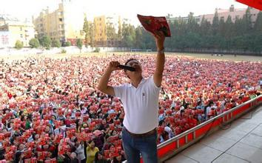

He’s a good English learner.
He studies English by
reading aloud.

Slide 3
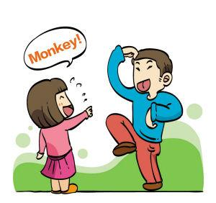


They study English by working with friends.
She studies English by
listening to tapes.

Slide 4
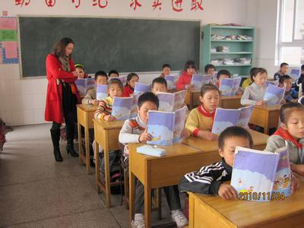
textbook
/tekstbuk/
They study English by reading textbook.

Slide 5
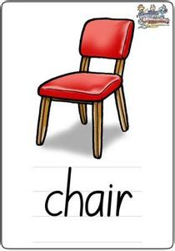
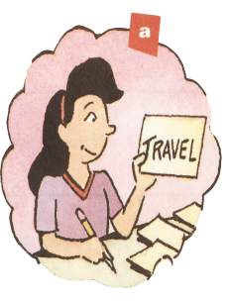
PPT模板：www.1ppt.com/moban/ PPT素材：www.1ppt.com/sucai/
PPT背景：www.1ppt.com/beijing/ PPT图表：www.1ppt.com/tubiao/
PPT下载：www.1ppt.com/xiazai/ PPT教程： www.1ppt.com/powerpoint/
资料下载：www.1ppt.com/ziliao/ 范文下载：www.1ppt.com/fanwen/
试卷下载：www.1ppt.com/shiti/ 教案下载：www.1ppt.com/jiaoan/
PPT论坛：www.1ppt.cn PPT课件：www.1ppt.com/kejian/
语文课件：www.1ppt.com/kejian/yuwen/ 数学课件：www.1ppt.com/kejian/shuxue/
英语课件：www.1ppt.com/kejian/yingyu/ 美术课件：www.1ppt.com/kejian/meishu/
科学课件：www.1ppt.com/kejian/kexue/ 物理课件：www.1ppt.com/kejian/wuli/
化学课件：www.1ppt.com/kejian/huaxue/ 生物课件：www.1ppt.com/kejian/shengwu/
地理课件：www.1ppt.com/kejian/dili/ 历史课件：www.1ppt.com/kejian/lishi/
a word card
She studies English by making word cards.
Notes:
PPT模板：www.1ppt.com/moban/ PPT素材：www.1ppt.com/sucai/
PPT背景：www.1ppt.com/beijing/ PPT图表：www.1ppt.com/tubiao/
PPT下载：www.1ppt.com/xiazai/ PPT教程： www.1ppt.com/powerpoint/
资料下载：www.1ppt.com/ziliao/ 范文下载：www.1ppt.com/fanwen/
试卷下载：www.1ppt.com/shiti/ 教案下载：www.1ppt.com/jiaoan/
PPT论坛：www.1ppt.cn PPT课件：www.1ppt.com/kejian/
语文课件：www.1ppt.com/kejian/yuwen/ 数学课件：www.1ppt.com/kejian/shuxue/
英语课件：www.1ppt.com/kejian/yingyu/ 美术课件：www.1ppt.com/kejian/meishu/
科学课件：www.1ppt.com/kejian/kexue/ 物理课件：www.1ppt.com/kejian/wuli/
化学课件：www.1ppt.com/kejian/huaxue/ 生物课件：www.1ppt.com/kejian/shengwu/
地理课件：www.1ppt.com/kejian/dili/ 历史课件：www.1ppt.com/kejian/lishi/

Slide 6
1a Check (✓) the ways you study English.
by working with friends
by making word cards
by reading the textbook
by listening to tapes
by asking the teacher for help

Slide 7
Discuss
What other ways to study English do you know?
by watching English programs on TV
by listening to English songs
by joining English clubs
by getting an English tutor（家庭教师）
by reading English magazines and newspapers
By using the Internet
by practicing conversations with friends

Slide 8


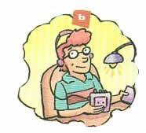
1b Listen. How do these students study for a test? Write letters from 1a above.
b
e
d
___
1. Meiping
____
2. Peter
____
3. Tony

Slide 9
Pairwork 1
Make conversations about how Meiping, Peter, Tony study for a test.
A: How does…study for a test?
B: She studies by…

Slide 10
Pairwork 2
Make conversations about how your classmates study for a test.
A: How do you study for a test, …?
B: I study by…

Slide 11
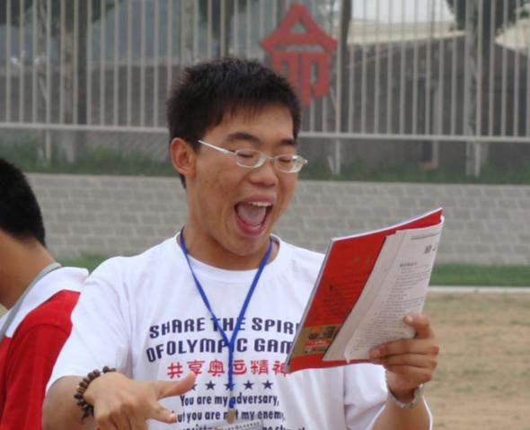

textbook
/tekstbuk/
pronunciation
/pr/
He practices pronunciation by reading aloud.

Slide 12
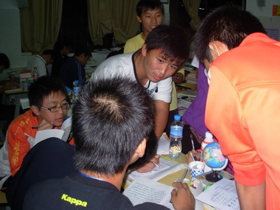
They study by working with a group.

Slide 13
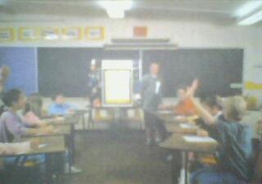
2a Listen and check the questions you hear.
What question is the teacher asking?

Slide 14

Questions | Answers
1._____ Do you learn English by watching videos? | _____
2.____ Do you have conversations with friends in English? | _____
3.____ What about listening to tapes? | _____
4._____ What about reading aloud to practice pronunciation? | _____
5.______ Have you ever studied with a group? | _____

Slide 15
2b Listen again, Match each question above with an answer below.
a. Yes, I have. I’ve learned a lot that way.
b. Oh, yes. It improves my speaking skills.
c. I do that sometimes. I think it helps.
d. No. It’s too hard to understand the voices.

Slide 16
Questions | Answers
1._____ Do you learn English by watching videos? | _____
2.____ Do you have conversations with friends in English? | _____
3.____ What about listening to tapes? | _____
4._____ What about reading aloud to practice pronunciation? | _____
5.______ Have you ever studied with a group? | _____
d
b
c
a

Slide 17
2c Pairwork
Make conversations using the information
from 2a and 2b.
A: Have you ever studied with a group?
B: I’ve learned a lot that way.

Slide 18
Questions | Answers
1._____ Do you learn English by watching videos? | _____
2.____ Do you have conversations with friends in English? | _____
3.____ What about listening to tapes? | _____
4._____ What about reading aloud to practice pronunciation? | _____
5.______ Have you ever studied with a group? | _____
d
b
c
a

Slide 19
Homework:
Make three short conversations like 1c.

